Slide 1

Leaders of Educational Thought
Comenius
Rousseau
Pestalozzi
Basedow
Knapp
Mann
Stimson
Dewey
Our Family Tree

Slide 2

Education Today
Education today is not characterized by:
  Rote memorization
  Book learning to the exclusion of any other type of learning
  Mindless devotion to the classics
  Blind adherence to learning Latin & Greek
  Overly stern discipline, bordering
  on child abuse
  Disregard for developmental
  characteristics of young people

Slide 3

Educational Leadership
At some point in time brave individuals said education needed to change direction
Who are these leaders of educational thought?

Slide 4
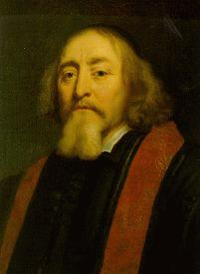
Educational Leaders - Era 1
JOHN AMOS COMENIUS
(1592-1670)
Comenius occupies a place in
education "of commanding
importance. He introduces and
dominates the whole modern movement in the field of elementary and secondary education.” Nicholas Butler, Columbia University

Slide 5
Comenius
Known as the “Father of Modern Education”
The Great Didactic was written around 1630. This and other writings lead to his reputation as one of the great educators of his era.
While his ideas seem simple today, they were considered to be radical in his time and were not accepted

Slide 6
Comenius advocated:
1. A four-stage system of education (similar to our present system)
    Schola Materna (The Mothers Knee) Ages 1-5. Comenius even wrote a book School of Infancy which detailed all phases of infant education.
    Schola Vernacula (Study of Language)
      Ages 6-11
      Every child would attend, classes were "desegregated," all subjects were graded to the maturity of the child, a uniform daily and yearly schedule, a teacher for each class, and hours of study determined by the child's capacity to learn.

Slide 7
Comenius advocated:
Four-stage system of education
    Schola Latina - Latin School (similar to Rome). Six years of study. Subject were grammar, natural philosophy (science), mathematics, ethics, dialectic, and rhetoric. Open to all students.
    University and Travel

Slide 8
Comenius advocated:
2. All the senses of a child should be involved in learning. Therefore the real thing should be used as much as possible in teaching or models depicting the real thing should be used.

Slide 9
Comenius advocated:
3. Pictures should be in books.
4. Children should learn in groups and should tell others in the group what they have learned (students shouldn’t be tutored privately)
5. Learning is more efficient if correlated with similar learning.

Slide 10
From The Great Didactic
"Men must, as far as possible, be taught to become wise by studying the heavens, the earth, oaks, beeches, but not by studying books; that is to say, they must learn to know and investigate the things themselves, and not the observations older people have made about the things."

Slide 11
From The Great Didactic
  "The turner shapes a block of wood with his axe before he turns it; the blacksmith heats iron before he hammers it; the clothweaver, before he spins his wool, first cleans, washes, cards, and fulls it; the shoemaker, before he sews the shoe, prepares, shapes, and smoothes the leather; but who, I ask, ever thinks it necessary that the teacher, in the same way, should make his pupils anxious for information, capable of receiving instruction, and therefore ready for a many-sided education, before he begins to place knowledge before them? …
    The desire to know and to learn should be excited in boys in every possible manner.
    The method of instruction should lighten the drudgery of learning that there may be nothing to hinder the scholars or deter them from making progress with their studies."

Slide 12
From The Great Didactic
  "What has to be done must be learned by practice. Artisans do not detain their apprentices with theories, but set them to do practical work at an early stage; thus they learn to forge by forging, to carve by carving, to paint by painting, and to dance by dancing. In schools, therefore, let the students learn to write by writing, to talk by talking, to sing by singing, and to reason by reasoning. In this way schools will become work-shops humming with work, and students whose efforts prove successful will experience the truth of the proverb: 'We give form to ourselves and to our materials at the same time.' Mechanics do not begin by drumming rules into their apprentices. They take them into the workshop and bid them to look at the work that has been produced, and then, when they wish to imitate this (for man is an imitative animal). They place tools in their hands and show them how they should be held and used. Then, if they make mistakes, they give them advice and correct them, often more by example than by mere words, and, as the facts show, the novices easily succeed in their imitation. No one has ever mastered any language or art by precept alone; while by practice this is possible, even without precept.

Slide 13
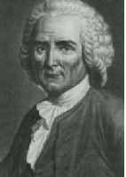
Educational Leaders - Era 1
Jean-Jacques Rousseau, 1712-1778
  Emphasize nature
    What is natural for children
      Sitting quiet for long periods of time?
      Understanding abstractions?
      Remaining quiet?
  Wrote a book “Emile” which described the ideal education of his son. Time was to be spent with a carpenter and in studying nature.
    Envisioned the “noble savage” as being the ideal

Slide 14
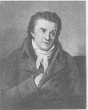
Educational Leaders - Era 1
Johann Heinrich Pestalozzi
(1746-1827)
First studied for the ministry,
then the law -- failed at both
Finally studied agriculture on the experimental farm of J.R. Tschiffeli (he didn’t realize Tschiffeli had won the Swiss Lottery, otherwise the farm would have been a financial failure)
Decided to run his own experimental farm

Slide 15
Pestalozzi
After the agricultural experiments failed, decided to start a school on the farm for poor children
    He taught all his pupils reading, writing, and arithmetic.
    The boys were taught farming, and the girls were taught gardening, housekeeping, and sewing.
    Pupils were supposed to earn their keep and help pay the school's expenses by spinning cotton.
    Pestalozzi's plan failed and he was forced to close his school.

Slide 16
Pestalozzi
  In 1798, Pestalozzi was appointed head of a school of orphans at Stans. He loved children and taught them practical things.
  A year later, he became a teacher at an elementary school in Burgdorf.
  He organized an institute for training teachers because his methods were so successful. He moved his institute to Yverdon. His most famous experiments were carried on at the institute. It was here where educators came from all parts of the world to study his methods and ideas.

Slide 17
Pestalozzi
His book Gertrude and Leonard expressed his views on education.
Horace Mann, secretary of education in Massachusetts visited the school established by Pestalozzi and promoted Pestalozzian thought in the US.

Slide 18
Educational Leaders - Era 1
Johann Bernhard Basedow (1723-1790)
After receiving an education and tutoring difficult children, turned his attention to education
  Wrote Methodenbuch in 1770
  Founded an experimental school named the Philanthropinum

Slide 19
Basedow
Believed the best way to get knowledge was through the senses and experience. If this was not possible use drawings and models.
Curriculum should emphasize
    Man
    Animals
    Trees and Plants
    Minerals and chemical elements
    Mathematical instruments
    Trades (using tools)
    Commerce

Slide 20
Basedow
Students should learn through group activity
Schools should be non-sectarian
Clergy should keep their nose out of public learning
Education should develop reason rather than memory
Education should be practical and playful
Education should include physical exercise

Slide 21
Educational Leaders - Era 1
Philipp Emanuel von Fellenberg (1771-1844)
His father was a friend of Pestalozzi
Established a successful agricultural institute for poor boys at Hofwyl (Switzerland) in 1808 based upon Pestalozzian principles
This school served as a model for European and American industrial schools

Slide 22

Educational Leaders - Era 1
Horace Mann (1796-1859)
Became First Secretary of the
State Board of Education in
Massachusetts in 1837
Published annual reports
  7th annual report was on the Pestalozzian approach to teaching

Slide 23
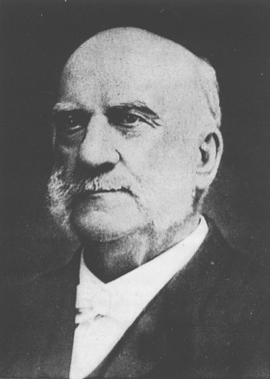
Educational Leaders - Era 2
Seaman Knapp (1833-1911)
Was president of Iowa State
Established Farm
Demonstration Work
Known as the Father of
Extension

Slide 24
Educational Leaders - Era 2
Rufus Stimson (1868-1947)
Was president of University of Connecticut, Director of Smith’s Agricultural School and State Supervisor of Agricultural Education in Massachusetts
Vitally involved in the development of agricultural education
Known as the Father of the Project Method of Teaching (SAE)

Slide 25
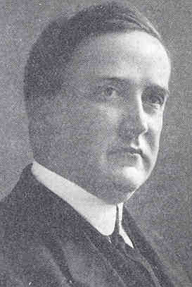
Educational Leaders - Era 2
Charles Prosser (1871-1952)
Was involved in the development
of vocational education in
Massachusetts
Wrote the Smith-Hughes Act
Served as the first Director of the Federal Board for Vocational Education
Strong proponent of a separate system of vocational education

Slide 26
Educational Leaders - Era 2
David Snedden - (1868-1951)
Influential in the development of vocational education. Saw it a way to solve problems of society.
Debated John Dewey as to whether vocational education should be narrowly focused (his view) or should be part of a broader education (Dewey’s view)

Slide 27
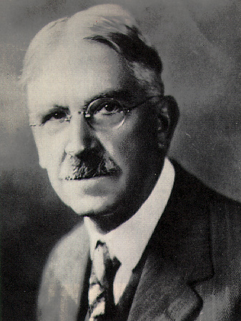
Educational Leaders - Era 2
John Dewey (1859-1952)
Was a failure as a teacher
Established a laboratory school
at the University of Chicago
where students learned through
“hands on activities”
Known for his work on problem-solving teaching
Wanted vocational education to be broad

Slide 28
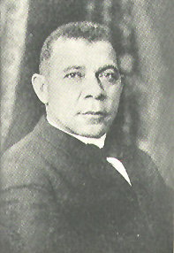
Educational Leaders - Era 2
Booker T. Washington
(1856-1915)
Founded Tuskegee Institute
Advocate of vocational
education/skill development
Had major differences with W.E.B. DuBois who wanted a classical education for the elite 10% of the Black race

Slide 29
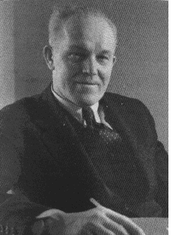
Educational Leaders - Era 2
Eduard C. Lindeman
(1885-1953)
Leader in Adult Education
Wrote The Meaning of Adult
Education in 1926
In teaching adults
  method is more important than curriculum
  experience is the important factor in adult learning

Slide 30
Educational Leaders - Era 3
H. M. Hamlin
Author of several books on community based agricultural education and using advisory committees
Faculty member at the University of Illinois for years
Came to NC State upon retirement

Slide 31
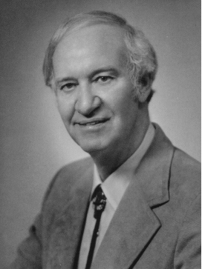
Educational Leaders - Era 3
Malcom Knowles (1913-1997)
Published several books on
adult education including The
Modern Practice of Adult
Education: Andragogy vs. Pedagogy
Even though Lindeman first
used andragogy to refer to adult education, Knowles popularized the term
Was a faculty member at NCSU

Slide 32
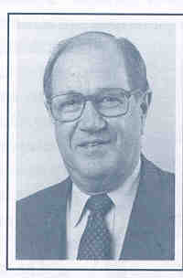
Educational Leaders - Era 3
J. Robert Warmbrod
Department Head at Ohio State
Renowned researcher
Advocated a more liberal definition of vocational education
Served on the National Research Council study of agricultural education in 1988

Slide 33
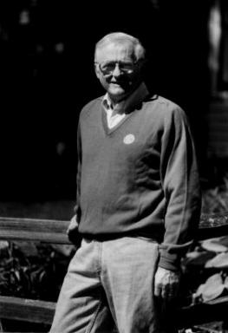
Educational Leaders - Era 3
Jerry Apps
Faculty member and
Department Chair in
CAVE (Continuing and
Vocational Education) at
the University of
Wisconsin-Madison. This department has been a national leader in extension education.

Slide 34
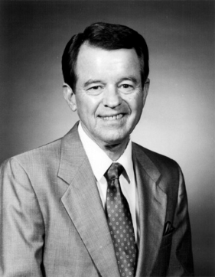
Educational Leaders - Era 3
Ed Boone
Established and chaired the
Department of Adult and
Community College Education
at North Carolina State
University in 1963
Boone’s model of adult education is widely recognized

Slide 35
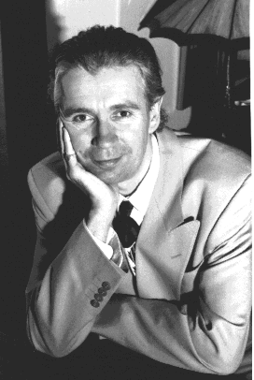
Educational Leaders - Era 3
Stephen Brookfield
Author of Understanding and
Facilitating Adult Learning
(1968)
Currently a faculty member at the University of St. Thomas in Minnesota

Slide 36
Educational Leaders - Era 3
The American Association for Agricultural Education has a Fellows programs. No more than 2 people a year can be selected as a Fellow. Being selected as a Fellow is an indication of national stature and leadership within the profession of agricultural education.

Slide 37
AAAE Fellows
Bob Warmbrod - OSU
Gary Moore - NCSU
David McCracken - OSU
Jasper Lee - MSU (now NCSU)
David Williams - ISU
Paul Vaughn - TTU
L. H. Newcomb - OSU
Glen Shinn - TAMU
Bob Birkenholz - UM
Al Mannebach – UConn
“Mac” McCaslin - OSU

Slide 38
Educational Leaders - Era 4
Will your name go here?

